Slide 1
GOVT. COLLEGE ROPAR
DEPARTMENT OF ECONOMICS
TOPIC -: PUBLIC AND PRIVATE SECTOR IN INDIA
INTRODUCTION.
OBEJECTIVE OF PUBLIC SECTOR AND GROWTH OF PRIVTE SECTOR.
ROLE OF PUBLIC SECTOR.
CAUSE OF LOW PROFITABILITY IN PUBLIC SECTOR AND MEASURES TO IMPROVE REFORM IN PUBLIC SECTOR.
CAUSES OF GROWTH IN PRIVATE SECTOR AND MEASURES TAKEN BY GOVT. TO IMPROVE PRIVATE SECTOR.
DIFFERENCE IN PUBLIC AND PRIVATE SECTOR.
PROF. RITU CLASS – B.A1 SEM 1

Slide 2
INTRODUCTION-:
PUBLIC SECTORE-Public sectors includes the public goods and governmental services such as the military, law enforcement, infrastructure, public transit, public education, along with health care and those working for the government itself, such as elected officials.
PRIVATE SECTORE-The private SECTORis the part of the economy that is run by individuals and companies for profit and is not state controlled. Therefore, it encompasses all for-profit businesses that are not owned or operated by the government. Companies and corporations that are government run are part of what is known as the public sector, while charities and other NO PROFIT ORGANIZATION are part of the voluntary sector.

Slide 3
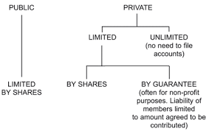
1

Slide 4
OBEJECTIVE OF PUBLIC SECTOR-:
TO INCREASE CAPITAL FORMATION.
TO SET UP HEAVY INDUSTRY.
TO PROMOTE ECONOMIC EQUALITY.
TO CHECK EVILS OF MONOPOLY.
TO PROMOTE SELF-RELIANCE.
TO INCREASE EMPOLYMENT.

Slide 5
GROWTH OF PRIVTE SECTOR IN INDIA-:
INCREASE IN NUMBER OF PRIVATE SECTOR COMPANIES.
INCREASE IN EMPLOYMENT IN PRIVATE ORGANISED SECTOR.
GROWTH OF SMALL-SCALE INDUSTRIES.
GROWTH OF BIG BUSINESS HOUSES.

Slide 6
CAUSE OF LOW PROFITABILITY IN PUBLIC SECTOR-:
1. Labour Problem:
The public sector en­terprises have also been hit by labour problems or deteriorating industrial relations. One of the causes of poor performance of such enterprises has been indiscipline among workers. We may also observe deteriorating labour-management relations in most large government enterprises where supervision is a very difficult task.
2.Cost Overruns:
Various surveys made on the working of public sector enterprises in In­dia have highlighted the point that most of the projects took longer time to complete than was initially envisaged. Such delays raised the cost of such projects, putting extra burden on the coun­try’s scarce resources.

Slide 7
MEASURES TO IMPROVE REFORM IN PUBLIC SECTOR-:
SECTORE CORPORATIONS
PROPER AUDITING.
COMMERCIAL OUTLOOK.
INSPECTION OF PUBLICE ENTERPRISES.
INCRREASE IN EFFICIENCY.
REFORMS IN LABOUR POLICY.

Slide 8
CAUSES OF GROWTH IN PRIVATE SECTOR-:
Inter-Company Investment: Inter-company investment is considered another important factor for the growth of large industrial houses and growing concentration of economic power. Through inter-company investment, big industrial houses occupy the directorship of a good number of companies and monopolized the decision-making of these companies.
Government’s Licensing Policy:The licensing policy of the Government has also facilitated the growth of large industrial houses and concentration of economic power. While giving industrial licence, the Government never tried to control the growth of monopoly or concentration of economic power. Rather, the licensing authorities had the tendency to sanction the licenses of new enterprises to experienced person having proven business ability, instead of new entrepreneurs.

Slide 9
MEASURES TAKEN BY GOVT. TO IMPROVE PRIVATE SECTOR-:
FINANCIAL ASSISTANCE.
INCREASE IN AREA FOR PRIVATE.
LIBERAL LICENSING.
LIBERAL IMPORT OF CAPITAL GOODS AND TECNOLOGY.
SUPPORT TO SMALL SCALE INDUSTRIES.

Slide 10
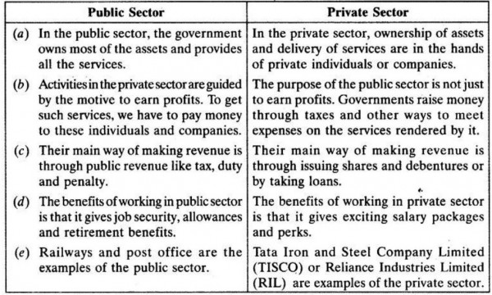
DIFFERENCE IN PUBLIC AND PRIVATE SECTOR-:

Slide 11
THANK YOU
A

